Slide 1
Convolutional Neural networks– CNN

Slide 2
Discrete 2D convolution

Slide 3
Discrete 2D convolution

Slide 4
Discrete 2D convolution

Slide 5
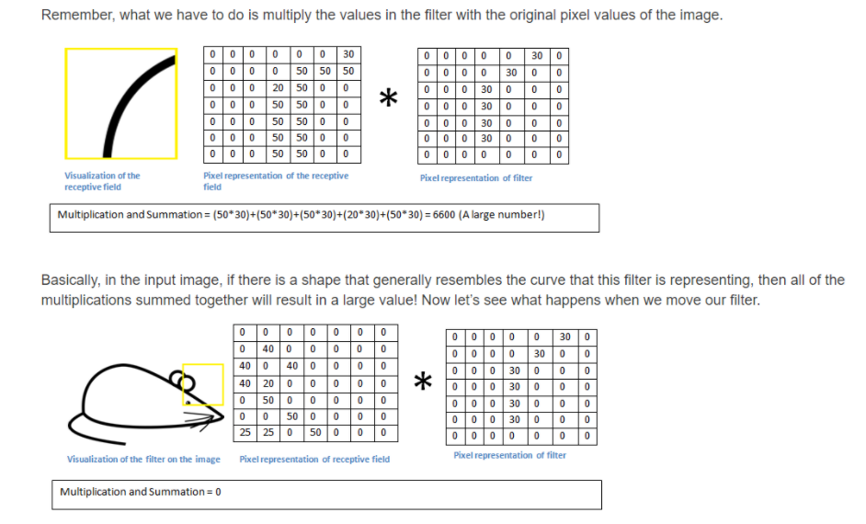
Discrete 2D convolution

Slide 6
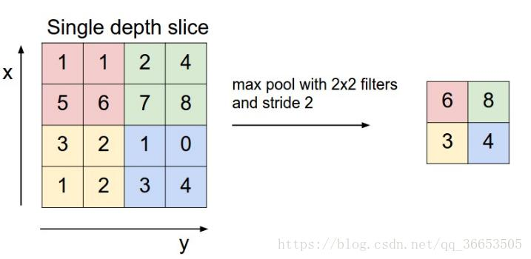
Pooling

Slide 7
Pooling

Slide 8
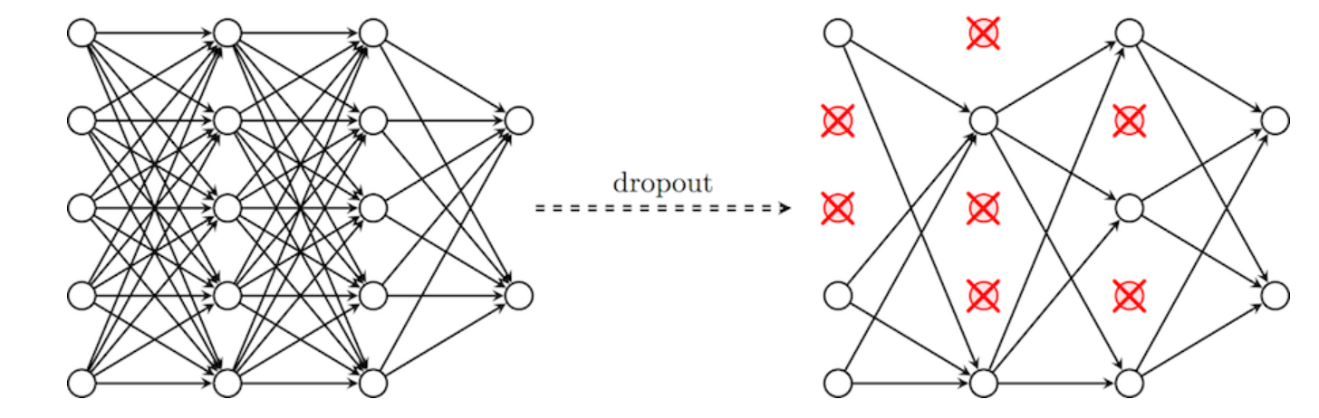
Dropout

Slide 9
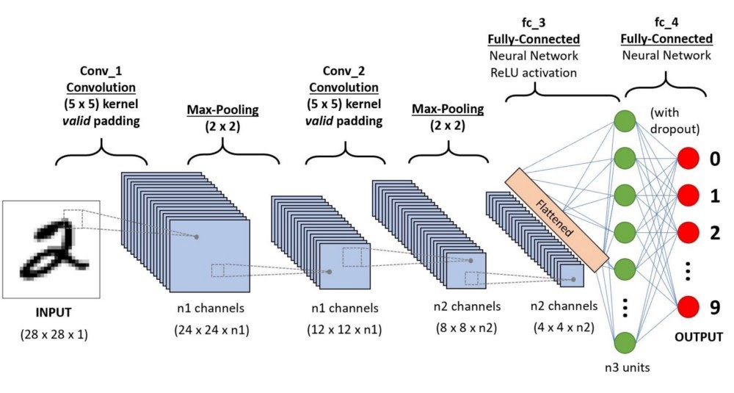
CNN

Slide 10
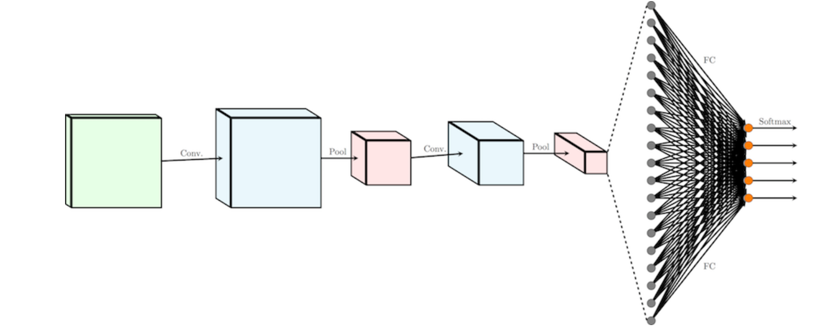
CNN

Slide 11
Questions

